Slide 1

SMART INDIA HACKATHON
2025
KISAAN MITRA
Problem Statement ID - 25030
Problem Statement Title - AI-Based Crop Recommendation For Farmers
Theme - Agriculture, FoodTech & Rural Development
PS Category - Software
Team ID
Team Name - Code Catalyst

Slide 2
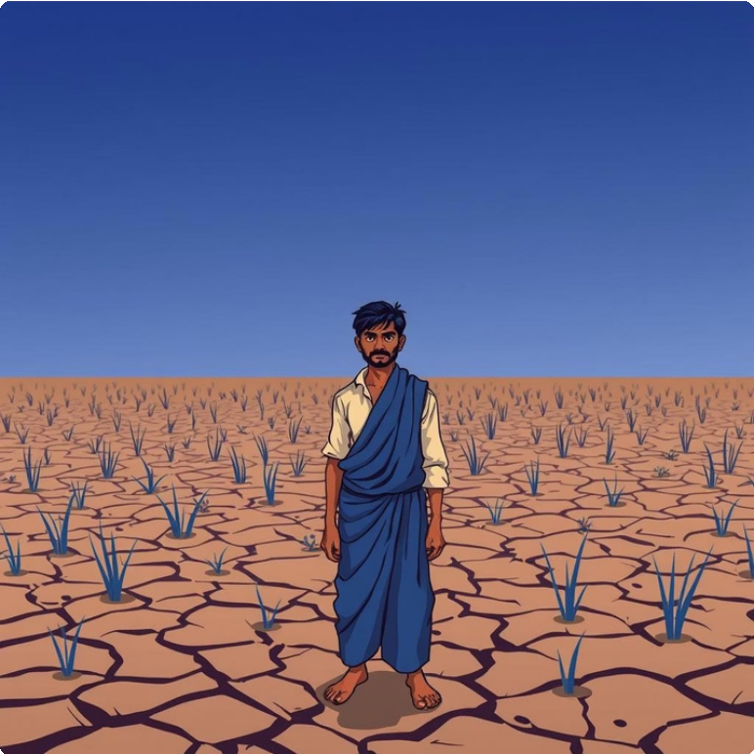
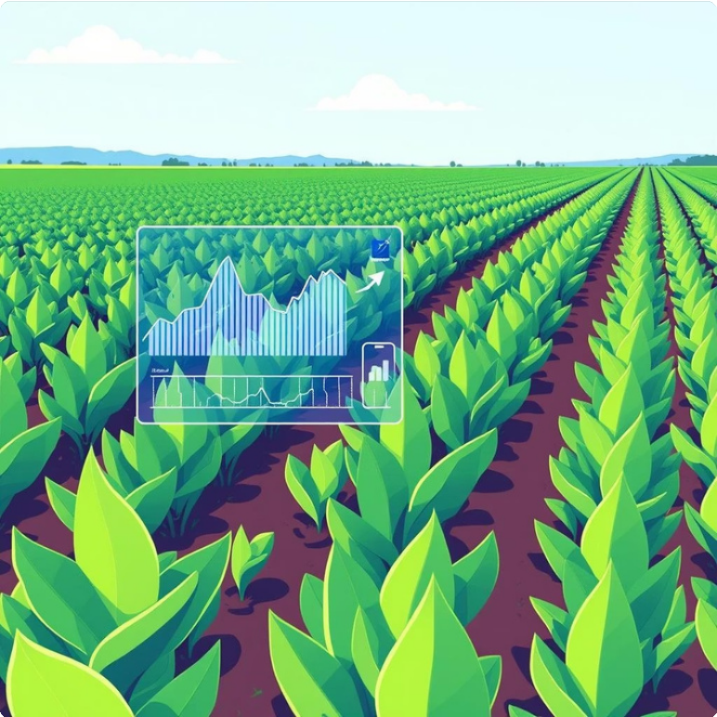
The Challenge: Suboptimal Farming
Our Solution:
A digital platform using MachineLearning for precise crop recommendations.
Traditional practices lead to low yields & financial losses.
Inefficient resource use (water, fertilizer). Lack of data-driven tools for small farmers.
Climate change and soil degradation intensify risks.
Analyzes 7 key environmental and soil parameters.
Suggests profitable and sustainable crops.
Empowers farmers with accessible, data-driven
insights.
Bridges the information agricultural ecosystem.
gap for a connected

Slide 3
Technical Approach: From Data to Recommendation
1
1. Data Input
Farmer provides Soil Data (N, P, K, pH) & Temperature.
3
3. ML Model
Random Forest model trained on 2200+ records predicts the best crop.
Technology Stack
Frontend: HTML, CSS, JS
Backend: Flask (Python),
ML Model: Scikit-learn, Pandas
2
2. Data Processing
Input data pre-processed for feeding into the model
4
4. Recommendation
Optimal crop displayed on user-friendly interface.
Deployment: Render

Slide 4
Key Features & Kisaan Mitra's Edge
High-Accuracy Recommendations
7-parametermodel (N,P, K, pH, Temp, Humidity, Rainfall) ensures scientific, precise advice.
Simple & Accessible Interface
Designed for all farmers,regardlessof digital literacy, with multiple vernacular language support.
Zero-Cost for Farmers
Builton open-sourcetechnologies, making it free and accessible to every farmer.
Extensible Platform
Architectureallows easyaddition of future modules like fertilizer, pest detection, and market prices.

Slide 5
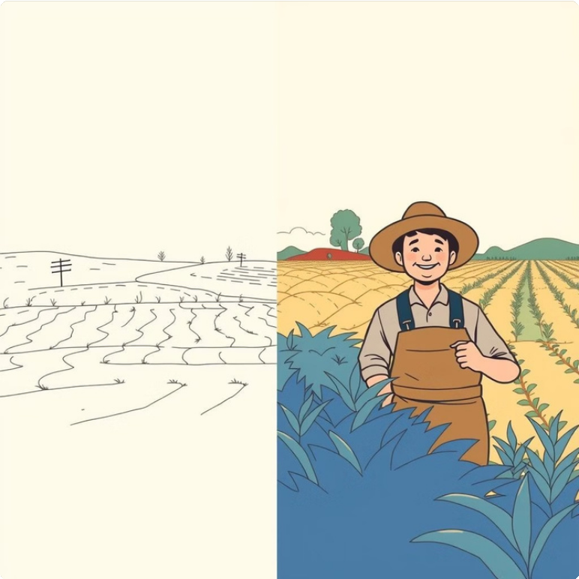

Impact & Viability: Cultivating a Better Future
Profound Impact
Increased Farmer Profitability: Optimized crop selection leads to higher yields and income.
Sustainable Agriculture: Promotes soil health and reduces resource depletion.
National Food Security: Improves productivity, contributing to a stable food supply.
Data-Driven Policy Making: Aggregated data informs government resource allocation.
Feasibility & Viability
Strong Government Alignment: Supports "Digital India" and "Doubling Farmers' Income."
High Adoption Potential: Leverages growing smartphone and 4G penetration in rural India.
Technically Feasible: Proven, robust, low-cost technology stack.
Scalable & Non-Disruptive: Integrates seamlessly without overhauling existing systems.

Slide 6
Future Roadmap & Conclusion
Phase 3: Advanced Development
Native Android app, AI-powered Pest & Disease Detection (camera).
Phase 2: Feature Expansion
Fertilizer Recommendation &real- time Mandi (Market) Price API.
Phase 1: Pilot Launch
Pilot in2-3districts(500+farmers), 10+ vernacular languages.
Thank You
GitHub Link: htt ps://github.com/Aakash-1857/Crop-Recommendation-System

